Slide 1



UNIVERSIDAD POLITÉCNICA DE MADRID
From Claims to Reality: Measuring Data Protection Compliance in Mobile Apps
Presented by:
David Rodríguez Torrado
Notes:
Common European Data Spaces and Robust AI for Transparent Public Governance

Slide 2
About me
David Rodríguez Torrado
Assistant Professor
Universidad Politécnica de Madrid (UPM)
Research focus
Privacy engineering, mobile app measurement, automated compliance assessment
Main Research Line
15 publications on automating GDPR compliance assessment
PETS, Computers & Security, IEEE Access, Computing, IEEE IWPE
Collaborations
CMU · ETH Zurich · King’s College London · Former Research Director · FTC EPN (Ecuador)

Slide 3






CONTEXT
Widespread privacy risks in mobile applications.
GDPR entered into force. Over 4.000M € in fines imposed since 2018.
~1500 apps are launched daily in the Google Play Store.
Manual review is unfeasible at scale.
Notes:
In response to growing concerns over privacy and data misuse, the European Union introduced the GDPR, which is considered one of the world’s strictest data protection laws. Its influence is global: many other countries have used it as a blueprint for their own data protection regulations.
But the GDPR is not just a theoretical standard: it’s being actively enforced. Since its adoption, over four billion euros in fines have been imposed, with the largest penalties targeting major digital platforms such as Meta, Amazon, and Google.
*Regulators keep a closer eye on major digital platforms / companies.*

Slide 4











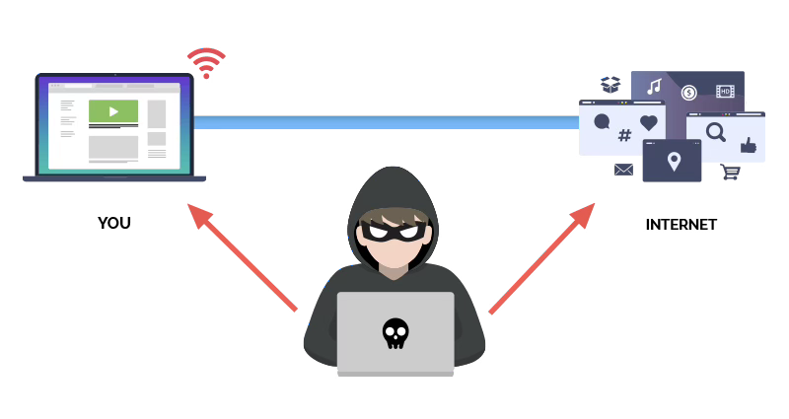

EVALUATION DESIGN
Privacy Policy
Disclosures
Privacy Labels
Compliance
Regulation
Non Compliance
Behavior

Slide 5





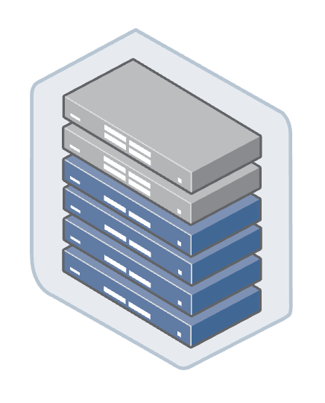



PLATFORM
CORE
Download
Storage
Analysis
API
Traffic
Search
Analysis
API

Slide 6



BEHAVIORAL ANALYSIS
domain.com?
SDK
Privacy Settings
(Facebook SDKs)
APP
?
Do developers enable
or disable settings?
HTTPs
Third-party
Library Analyzer
Recipient Identifier
SDK Configuration

Slide 7




POLICY ANALYSIS
SVMs
Privacy
Policy
Data Retention Periods
Privacy Policy
Data Collection Practices
Data Sharing Practices
International Transfers
Multi-purpose approach
Disclosure Checker

Slide 8
COMPLIANCE FINDINGS
48% of apps sending data outside the EU (out of 4,593)
    Fail to comply with GDPR transfer requirements (Art. 44 - 49)
81% of apps sending personal data to third-party recipients (out of 4,335)
    Fail to disclose data sharing or the recipients’ identity (Art. 13(1)(e))
50.2% of apps collecting personal data (out of 2,235)
    Do not disclose data retention periods (Art. 13(2)(a))
22% of apps collecting personal data (out of 4,335)
    Do not disclose the identity of the data controller (Art. 13(1)(a))

Slide 9
Underlying Causes of Non-Compliance
SDK Ecosystem
Developer Configuration
Transparency Gap
Third-party libraries widely used
(e.g., Facebook SDK present in >50% popular apps)
73.7% of undisclosed third-party transfers involve SDKs
Data collection settings enabled by default
SDKs introduce additional data flows
Developers often keep default SDK settings
Frequent misalignments between:
Privacy policies ↔ behavior
Privacy labels ↔ behavior
Policies ↔ labels
Limited understanding of SDK behavior
+
Lack of Documentation

Slide 10
TAKEAWAYS
Automated compliance assessment is feasible.
  Automated methods enable large-scale screening of GDPR transparency requirements
Compliance violations are widespread.
  SDKs play a central role in these violations
Improving compliance requires changes at the ecosystem level.
  Privacy-by-default SDK configurations
  Better developer tooling for compliance checks
  Clearer documentation of SDK data practices
Notes:
Our findings suggest that improving compliance will likely require changes at the ecosystem level — including privacy-by-default SDK designs, better developer tooling, and clearer documentation of SDK data practices.

Slide 11



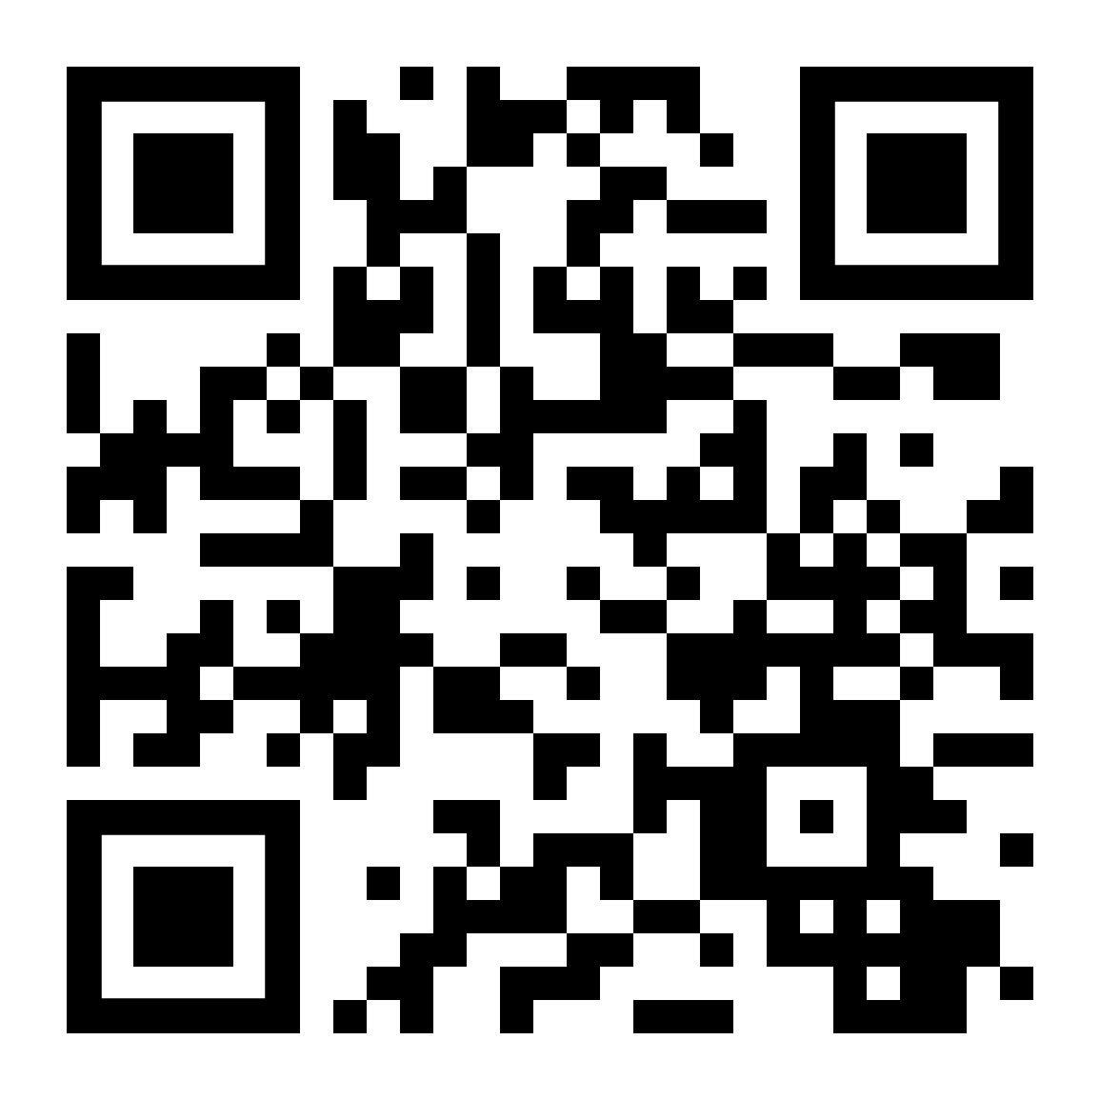
THANK YOU
FOR YOUR ATTENTION
This work has been partially supported by the Re-InitS project, funded by the Plan Estatal de Investigación Científica y Técnica y de Innovación 2024-2027 (Ministerio de Ciencia e Investigación (Spain) - MCIN/AEI/10.13039/501100011033) under grant agreement PID2024-155230OB-C43.

